Slide 1

Practical Arduino
From the Ground Up

Slide 2
Potential Course Outline (assumes no Prior electronics or Arduino knowledge)
Crawl: What you will learn. What you will need. Primer on Components and Symbols. Conductors, Insulators and Ohms Law. Introduce the kit and how to obtain one.
Walk: Schematic vs PCB. Start it simple. Work up to this design complete walkthrough. (parts orientation, details, tips and tricks, how to solder, assemble board.) Build up the power supply portion the board. How to test your work with visual inspection and basic electrical testing.
Run: Finish the build. Introduce The Arduino IDE. Use of built in test programs like Blink, Servo. Show how to modify and test beyond the default. Use of serial monitor and serial plotter for debugging.
Mergduino Applications: Examples of practical use (Each as a standalone short video)
LED outputs (timing and random light)
Button Inputs (debouncing and controlling program flow)
Infrared detectors (sensor needed)
LDR sensors (LDR needed)
Motor Control (Motor Shield needed)
LCD displays (LCD display needed)

Slide 3
MergDuino Overview
Basis:
An Arduino based hardware and software project that will serve as a learning platform and a useful tool when completed.
Finished product would be very useful in a variety of situations on any layout and has good growth potential.
Ideally ordered as a complete kit. (PCB, all components, including Arduino NANO (clone))
Detailed instructions suitable for novices. Broken down as ‘build’, ‘test’, ‘learn’.
A series of videos can be made for self paced learning (able to pause, go back, review and check)
PCB design should be flexible in that I/O can be reconfigured without too much fuss. (for example taking LED’s off board)
No expectation of ‘live sessions’ other than maybe introducing the kit once it is available
Feature List:
Socketable NANO on a carrier board.
Carrier board itself to have mounting holes.
Flexible input power (AC/DC/DCC)
On board regulation to 5Vdc direct into NANO 5 Volt input
Header pins aligned with standard servo pinout
On board output driver chip can power small relays or actuators.
On board R680 current limiting resistors
2 board mounted Pushbuttons as DI’s
A small prototype test area.
Multiple communications options (Although not all options may be physically possible on the same build)
AC/DC or DCC powered
4 LEDs on board
ULN2803A Output Driver
DCC signal via optocoupler
2 SERVO via 3pin Header
NANO V3 MCU
2 Buttons on board
Comms Header for CMRI/CBUS (Rx, Tx, D2)
8 Analog & 4 Digital Sensors via 3 pin header
I2C with SDA/SCL
Carrier Board

Slide 4
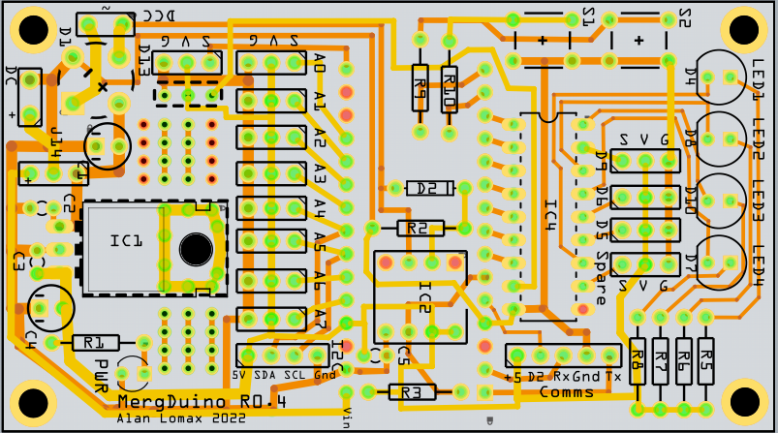
MERGduino : PCB

Slide 5
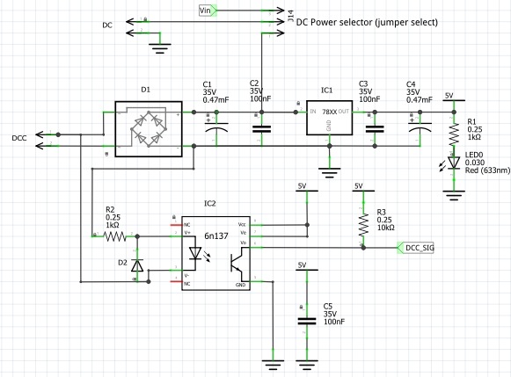
MERGduino: Power Supply
Feature List (Power):
Flexible input power (AC / DCC or DC)
On board regulation to 5vdc for NANO 5VDC Input
PS cold be built standalone as just a ‘power supply’ providing 5 volts.
Jumper to select routing DC-in to either regulator circuit or Vin on Nano.
Lots of header pin positions can be used for power take off.
On board LED (for troubleshooting without NANO involved)
Feature List (DCC Opto-Coupler):
Optional. Optically couples DCC onto to Arduino Pin D3
Enables Arduino to act as a stationary Accessory decoder
Installed under the NANO to save PCB space.

Slide 6
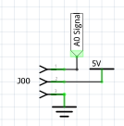

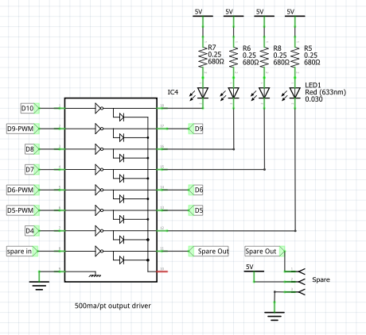
MERGduino: I/O
Left
Standard I/O header with pins in order (Signal, 5VDC, Gnd)
Suitable for Servos and many types of sensors.
Suitable for AI, AO, DI, DO with or without internal pullup
8 Analog pins and 4 digital pins
Middle
Two on Board buttons for testing or getting user input.
(use with internal pullup).
Also Includes current limiting resistor in case the pin is accidentally configured for output and then the button is pushed
Bottom
LN2903 output driver.
If not used jumpers can easily be installed directly across.
If included allows a sinking current of 500 ma per pin. Can power small relays, incandescent bulbs, light strips.
4 on board LED’s with current limiting resistors for experimenting.
LED’s could be remote mounted as signals, building lighting, mimic panel
PWM pins available for driving motor shields. (or others)
One spare driver channel has in/out header connection available

Slide 7
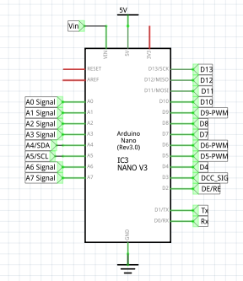
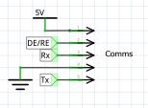
MERGduino: CPU
Standard NANO V3 Clone
To be mounted on header pins which are soldered onto the main board
Optoisolator and other small components will be under the NANO
All I/O pins land somewhere and are available for use.
PWM pins called out especially for use on SERVO’s or Motor control
I2C brought out to 4 pin header for connection to servo expander
Tx/Rx available on 5 pin header (with +5 Gnd and a 3rd digital pin so this is suitable for wide range of coms oriented hat connections. (RS485 / CBUS etc). Pins arranged so that reversal of plug should not damage anything.

Slide 8
MERGduino: Status
Phase | Description | Conditions for Going Forward | Decision | When
0 | Idea | Someone is willing to work it | Yes – Alan | Dec 2021
1 | Definition | Requirements are set. | Yes – Alan | Jan 2022
2 | Basic Design | Schematic Laid out Rev 0.1 | Yes – Alan | Jan 2022
3 | Detailed Design | PCB Laid Out Rev 0.1 Design Review 0.2/0.3/0.4 Mapped against requirements | Yes – Alan | Jan 2022
4 | Execution | Previous stage completed Jan 31/2022 Test build. Develop first draft assembly instructions Early experimentation | Prototypes on order | Feb 2022
5 | Commissioning | Rev 1assembly instructions Parts List. Early adopter / broaden code base.
6 | Closeout | Considered ‘done’ and ready for use. | Here ‘closed’ means ready to publish for early adopters and develop learning material against.

Slide 9
MERGduino: issues and outcomes
Item | Description | Reasons Why | Reasons Why NOT | Decision | When
0 | Use 5 VDC Power to Arduino instead of Vin | Using a 7805 gives more flexible input power options including standard 9 volt battery and 12 VDC. Offloads the NANO regulator. | Reference design used a 7812 | 7805 | Jan 2022
1 | Line Driver IC | Allows higher current loads of independent voltages. Protects NANO | Cost in terms of PCB space Part cost (pennies) | Keep | Jan 2022
2 | Choice of Current Limiting R value | R330 and R470 was traditional | New LED’s more efficient use R680 or even R1K | R680 | Jan 2022
3 | External I2C pullup R | Education. Simple soldering job and use of DMM lessons. Ohms Law. | Internal pullups work. Ohms law and I2C are opposite ends of pool. | Internal | Jan 2022
4 | Include MAX485 | Comms/RS485/CMRI connectivity | Cost in terms of PCB space Part cost (pennies) | No (but header available) | Jan 2022
5 | Include MP3 dfPlayer | Sound Fx is another area of interest. | Cost in terms of PCB space Part cost (pennies) | No (but header available) | Jan 2022

Slide 10
MERGduino: Feb 2 / 2022 Update
Pre-Production schematic done – (Rev 0.4)
PCB laid out and verified
Small order (3 boards only) placed. Additional Components for build-out are coming in now.
Interest? Thoughts?
Down the road … (after preliminary build / test) Form a team to lead evaluation?

